Slide 1
COMP814 – Text Mining Neural Networks and Matrix basics

Slide 2
Word2ec/Word Embedding (Review)
Representation of a document or a discourse with a data structure.
So as to be able to do operations on it.
Vector of words
Can do vector and other mathematical operations
So that documents can be ranked

Slide 3
Vector representation of a corpus (Review)
 | d₁ | d₂ | d₃ | …….. | d_{n}
t₁ | w₁₁ | w₁₂ | W₁₃ | …….. | w_{1n}
t₂ | w₂₁ | w₂₂ | W₂₃ | …….. | w_{1n}
. . . . | . . . . | . . . . | . . . . | . . . . | . . . .
t_{m} | w_{m1} | w_{m2} | W_{m3} | …….. | w_{mn}

Slide 4
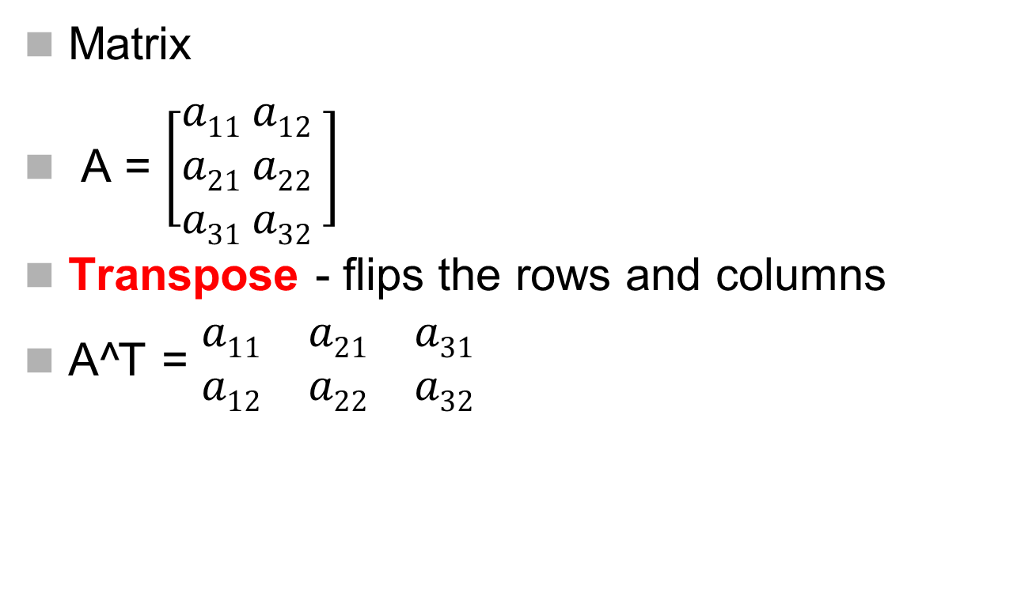
Matrix arithmetic basics
Matrix
A = $\left[\begin{aligned}a11 a12 \\ a21 a22 \\ a31 a32 \end{aligned}\right]$
Transpose - flips the rows and columns
A^T = $\begin{matrix}a11 & a21 & a31 \\ a12 & a22 & a32\end{matrix}$

Slide 5
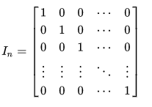
Matrix inversion
Matrix Inversion – matrix which when multiplied with the matrix give the identity matrix
Identity (unit) matrix – matrix with 1’s on the main diagonal

Slide 6
Others…
Trace – for a square matrix gives the sum of value on the main diagonal
Determinant – for a square matrix is the scalar representation for the volume of the matrix. Volume is for the parallelepiped projected by the three vector points relative to the origin.

Slide 7
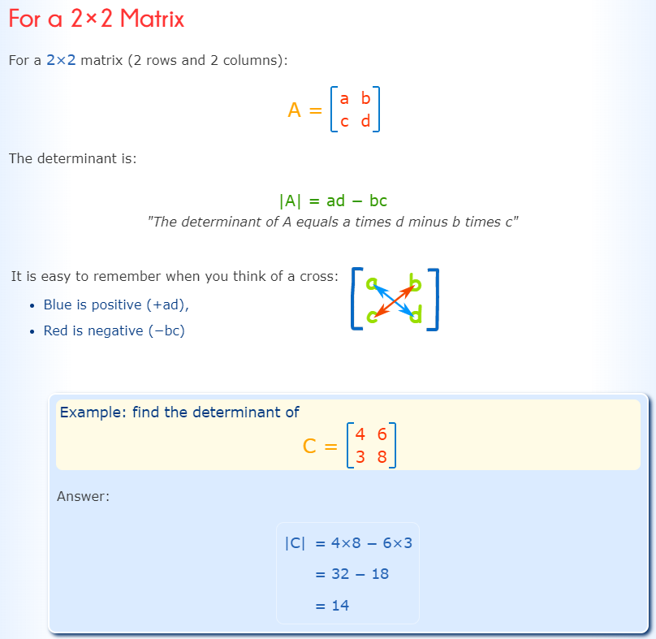

Slide 8
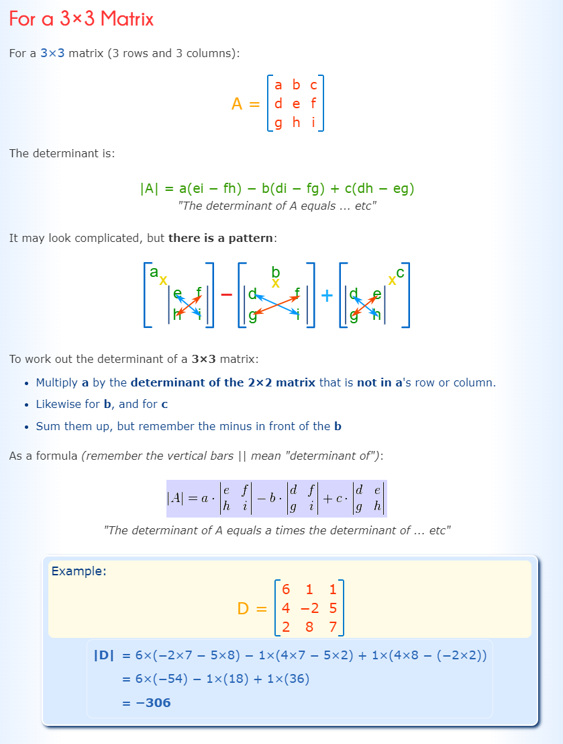

Slide 9
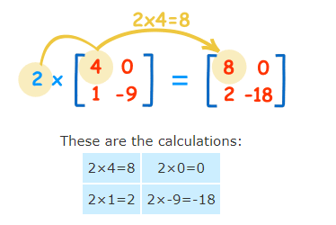
Matrix multiplication
Scalar multiplication

Slide 10
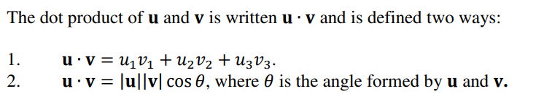
Dot product
Dot product of two matrices is a scaler.
|u| is called the determinant
Is square root of the squares of all the components.
Can be used to represent various quantities such as work done by two forces or the “distance” between the two vectors.
For text processing : similarity between the two vectors.

Slide 11
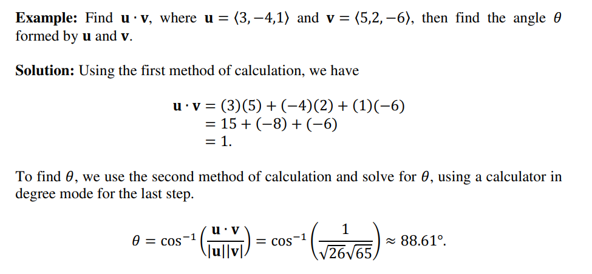
Dot product example

Slide 12
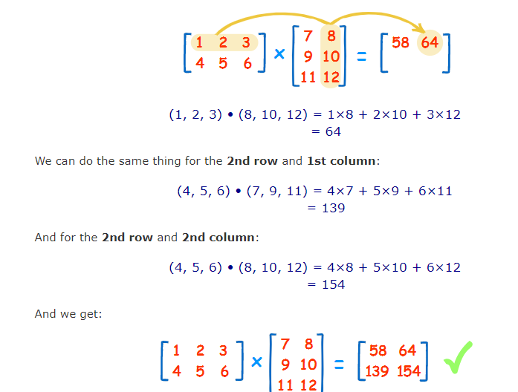
Cross product
mxn . nxq = mxq (the inner values (n) should be same.

Slide 13
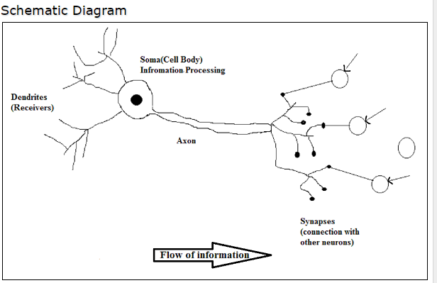
Biological Neuron

Slide 14
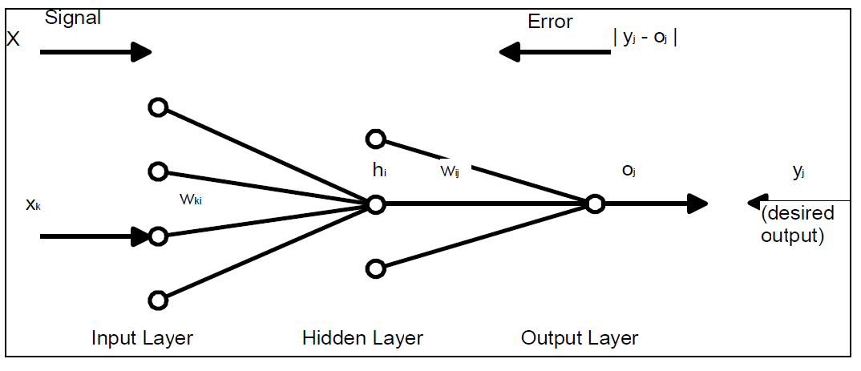
ANN

Slide 15
(A)NN Basics
Neural Networks – networks of neurons
Artificial Neurons – crude approximations of biological neurons.
Artificial Neural Networks (ANNs) - networks of Artificial Neurons and hence constitute crude approximations to parts of real brains.
Could be physical devices, or simulated on conventional computers.

Slide 16
Some characteristics of ANNs
Extremely powerful computational devices.
Can naturally use parallelism which makes them very efficient.
Can learn and generalize from training data – so there is no need for enormous feats of programming.
Are particularly fault tolerant.
Are very noise tolerant – so they can cope with situations where normal symbolic systems would have difficulty.
In principle, they can do anything a symbolic/logic system can do, and more.
Unlike some other types of models (eg. Decision trees) it is not possible to map back decisions back to individual features.
Decisions (classifications) can’t be explained.

Slide 17
Some characteristics of ANNs
Extremely powerful computational devices.
Can naturally use parallelism which makes them very efficient.
Can learn and generalize from training data – so there is no need for enormous feats of programming.
Are particularly fault tolerant.
Are very noise tolerant – so they can cope with situations where normal symbolic systems would have difficulty.
In principle, they can do anything a symbolic/logic system can do, and more.
Unlike some other types of models (eg. Decision trees) it is not possible to map back decisions back to individual features.
Decisions (classifications) can’t be explained.

Slide 18
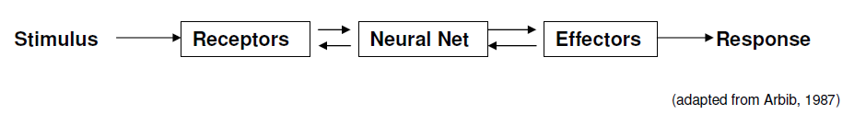
Biological Nervous system.
Receptors convert stimuli from the external environment into electrical impulses.
Effectors convert electrical impulses generated by the neural net into responses as system outputs.
Neural net (brain) continually receives information, perceives it and makes appropriate decisions.
Flow of information is represented by arrows – feedforward and feedback.

Slide 19
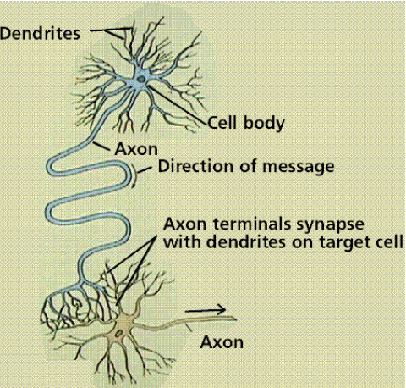
Schematic Diagram of a Biological Neuron
The majority of neurons encode their outputs or activations as a series of brief electrical pulses (i.e. spikes or action potentials).
Dendrites are the receptive zones that receive activation from other neurons.
The cell body (soma) of the neuron’s processes the incoming activations and converts them into output activations.
Axons are transmission lines that send activation to other neurons.
Synapses allow weighted transmission of signals using neurotransmitters) between axons and dendrites to build up large neural networks. They form the junction of Axion and dendrites.

Slide 20
Brain versus Computers
Processing elements: There are 1014 synapses in the brain,
compared with 108 transistors in the computer.
Processing speed: 100 Hz for the brain compared to GHz for the computer.
Style of computation: The brain computes in parallel and distributed mode, whereas the computer mostly serially and centralized.
Fault tolerant: The brain is fault tolerant, whereas the computer is not.
Adaptive: The brain learns fast, whereas the computer doesn’t even compare with an infant’s learning capabilities.
Intelligence and consciousness: The brain is highly intelligent and conscious, whereas the computer shows lack of intelligence.
Evolution: The brains have been evolving for tens of millions of years, computers have been evolving for decades.

Slide 21
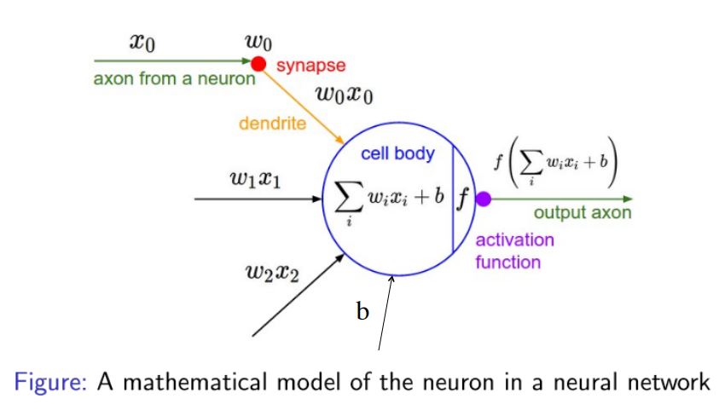
Mathematical neuron

Slide 22
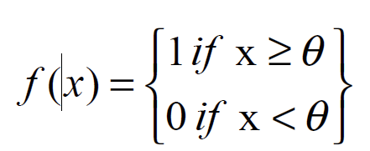
Activation Functions
A set of synapses (i.e. connections) brings in activations from other neurons
A processing unit sums the inputs, and then applies a non-linear activation function
An output line transmits the result to other neurons
ϴ is called the threshold

Slide 23
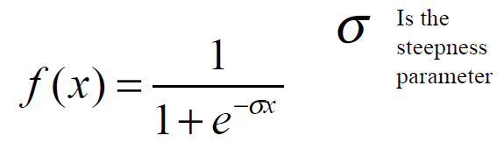
The Sigmoidal step function
The math of some neural nets requires that the activation function be continuously differentiable
A sigmoidal function often used to approximate the step function

Slide 24
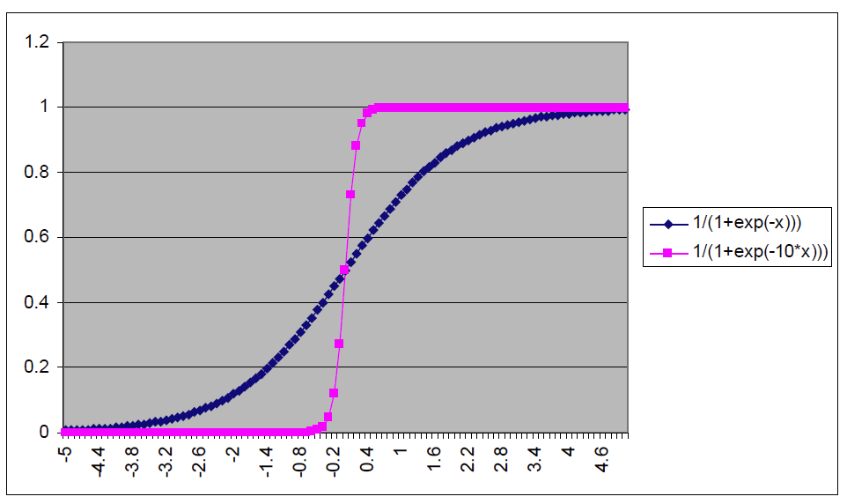
Sigmoidal Steepness

Slide 25
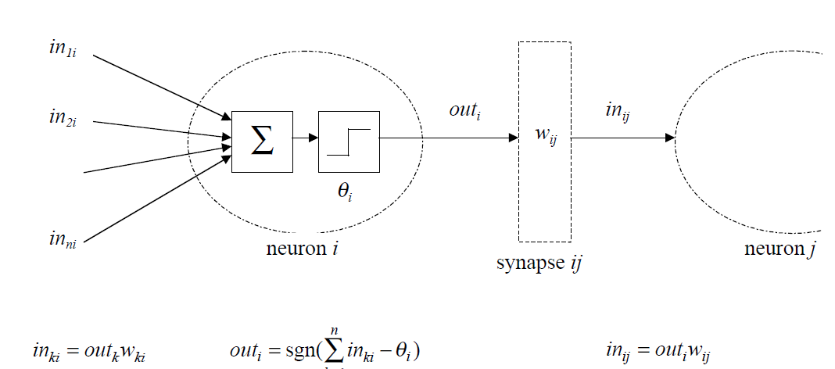
Networks of McCulloch-Pitts Neurons
Artificial neurons have the same basic components as biological neurons. The simplest ANNs consist of a set of McCulloch-Pitts neurons labelled by indices k, i, j and activation flows between them via synapses with strengths w_{ki}, w_{ij}:
A set of synapses (i.e. connections) brings in activations from other neurons
A processing unit sums the inputs, and then applies a non-linear activation function
An output line transmits the result to other neurons

Slide 26
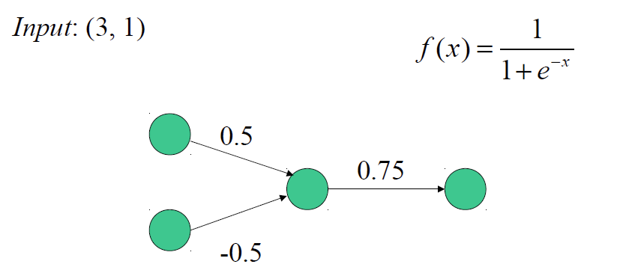
A 2-Layer Example
Example solution
Activation of hidden unit
f(0.5(3) + -0.5(1))
= f(1.5 – 0.5)
= f(1) = 0.731
Output activation
= f(0.731(0.75))
= f(0.548)
= 0.634

Slide 27
Building up a NN
Row vector provides weights for a single unit in “right” layer
A weight matrix provides all weights connecting “left” layer to “right” layer
Let W be a n x r weight matrix
Row vector i in matrix connects unit i on “right” layer to units in “left” layer
n units in layer to “right”
r units in layer to “left”

Slide 28
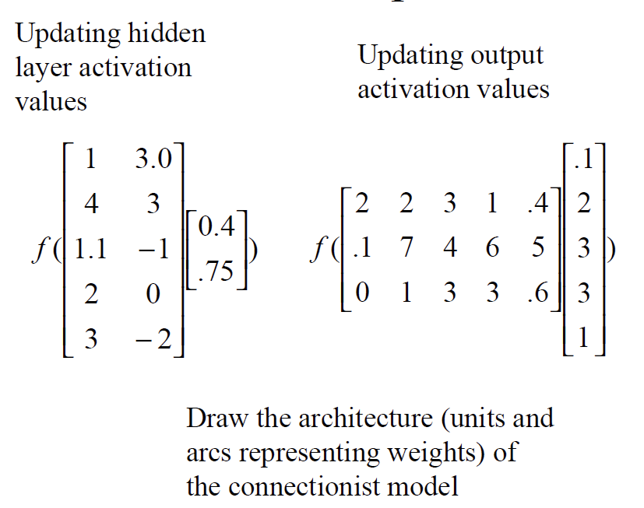
Example
• 2 input units
• 5 hidden layer units
• 3 output units
• Fully connected, feedforward network

Slide 29
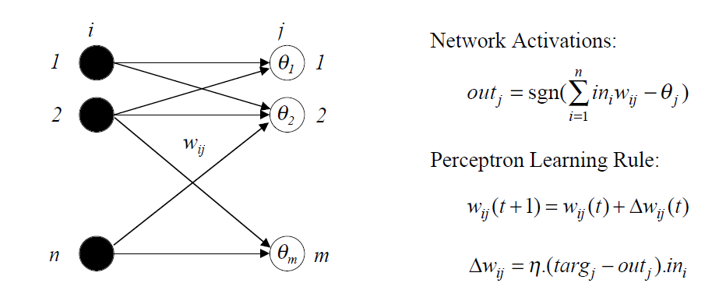
The perceptron and Learning
An arrangement of one input layer of activations feeding forward to one output layer of McCulloch-Pitts neurons is known as a simple Perceptron:
The Perceptron Learning Rule iteratively shifts around the weights wij and hence the decision boundaries to give the target outputs for each input.

Slide 30


Learning by Gradient Descent Error Minimisation
Learning is minimisation of the difference between the actual outputs and the target outputs.
We can quantify this difference by defining the Sum Squared Error function, summed over all output units j and all training patterns p:
The ½ is a constant added to cancel when the equation is differentiated.
It is the general aim of network learning to minimise this error by adjusting the weights.
Typically we make a series of small adjustments to the weights until the error is ‘small enough’. We can determine which direction to change the weights in by looking at the gradients (i.e. partial derivatives) of E with respect to each weight.
Then the gradient descent update equation (with positive learning rate Ƞ) is
This can be applied iteratively to minimise the error.

Slide 31
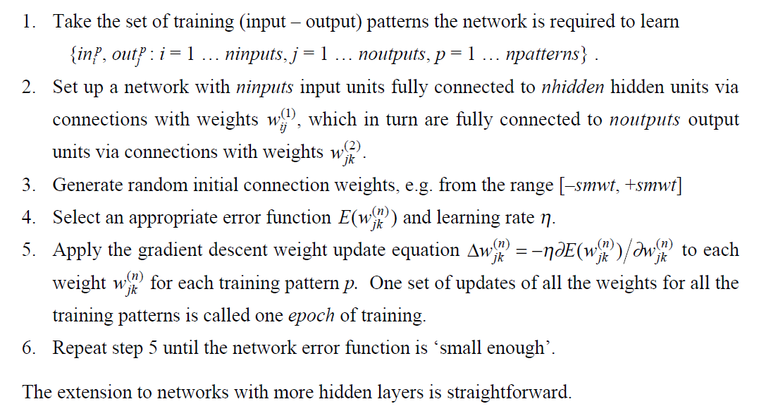
Training a Two-Layer MLP Network

Slide 32
Characteristics/factors pertinent to Deep Learning
Does not require you to label everything.
Advantage over previous NN and other machine learning algorithms is that DP is able to extrapolate new features from a limited set of features contained in the training set. It will search for other features that correlates with the existing features.
With NN, you can debug but cannot map back decisions to individual features, with random forest decision trees you can.
With DP, you can not tell why it reached a certain decision as it is based on hidden nets that create their own features, exploiting on the manual features created in the training set.
DP learning lacks feature introspection

Slide 33
Characteristics/factors pertinent to Deep Learning (cont)
One-hot or one-on representation – word vector the size of vocab.
Sparse
Cannot represent similarity between words. Eg. “hotel” and “motel”
Convolutional NN – use pooling architectures – not fully connected.
Usually used in deep learning.
Recurrent NN – has loops where outputs are used back as inputs so signals don’t travel as a directed graph, rather in both directions.
Recursive NN – are generalizations of recurrent networks which can handle trees.
Back propagation – when the error is propagated backwards from the output layer to optimize the weights.

Slide 34
Introduction to Deep Leaning and Tensor Flow
Deep Learning – is the use of a special (deep) type of neural network to model solutions to problems.
Tensor Flow – is an (open source) implementation of deep learning model in Python which is shipped as an external library.
Keras - is a powerful and easy-to-use free open source Python library for developing and evaluating deep learning models. It is part of the TensorFlow library and allows you to define and train neural network models in just a few lines of code.
Use of NN to model problems is old but deep layering has picked up momentum due to increasing computational power and genre of problems being tacked - mainly text and vision processing.
Main advantage of DP – can extrapolate new features from basic features in the training set.

Slide 35
Demo Code

